Slide 1
Data Structures
Lecture -6

Slide 2
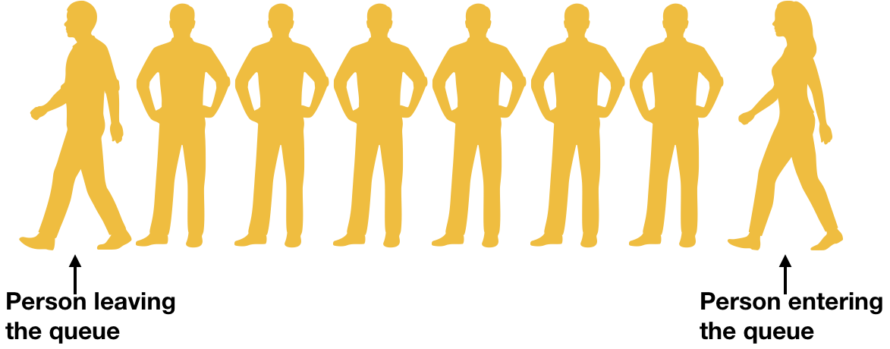
Queue
Definition: A Queue is an ordered collection of elements in which all insertion take place at one end, the rear, whereas all deletion take place at the other end, the front. Queue follows First In First Out (FIFO).
Queues are 3 types
Linear Queues
Circular Queues
De Queues

Slide 3
Queue
Another form of restricted list
Insertion is done at one end, whereas deletion is performed at the other end
Basic operations:
enqueue: insert an element at the rear of the list
dequeue: delete the element at the front of the list
dequeue
enqueue

Slide 4
Linear Queue
In Linear Queue initially front=0 and rear=-1. To insert an element increase rear by 1 and insert element in rear position. If rear = n-1 queue is full. To delete an element increase front by 1. If front > rear Queue is empty.
rear=-1
front=0
SIZE = 8
Queue

Slide 5
Linear Queue
rear=-1
front=0
SIZE = 8
Queue
Initial State of Queue

Slide 6
Linear Queue
rear=0
front=0
SIZE = 8
Queue
10
Enqueue(10)

Slide 7
Linear Queue
rear=1
front=0
SIZE = 8
Queue
10 | 20
Enqueue(20)

Slide 8
Linear Queue
rear=4
front=0
SIZE = 8
Queue
10 | 20
30
40
50
Enqueue(30)
Enqueue(40)
Enqueue(50)

Slide 9
Linear Queue
front=1
rear=4
front=0
SIZE = 8
Queue
10 | 20
30
40
50
denqueue()

Slide 10
Thank You

